Slide 1
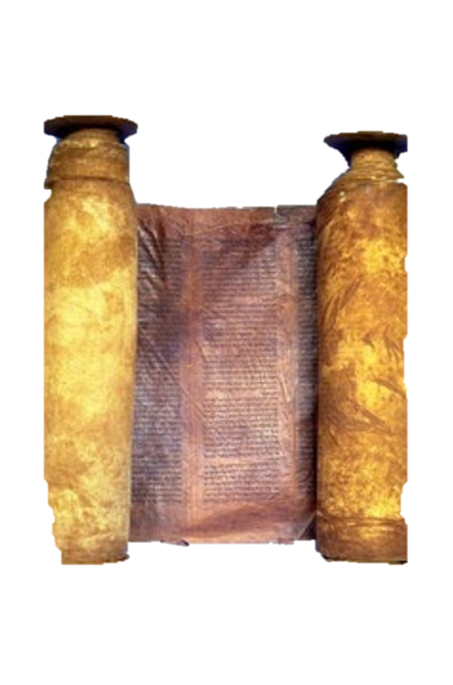
A free CD of this message will be available immediately following the service
2 Kings
11-13
A podcast will also be available later this week at calvaryokc.com

Slide 2
Israel
Judah
Ahaziah, 853-852
Jehoshaphat, 871-847
Jehoram, 852-841
Jehoram, 847-840
Azariah, 840
Jehu, 841-814
Athaliah, 840-835
c
2 kings 11-13

Slide 3
Sam. 7:16 ~ And your (David) house and your kingdom shall be established forever before you. Your throne shall be established forever.
2 kings 11-13

Slide 4
2 kings 11-13

Slide 5
Deut. 17:18-20 ~ ¹⁸ Also it shall be, when he sits on the throne of his kingdom, that he shall write for himself a copy of this law in a book, from the one before the priests, the Levites. ¹⁹ And it shall be with him, and he shall read it all the days of his life, that he may learn to fear the Lord his God and
2 kings 11-13

Slide 6
be careful to observe all the words of this law and these statutes, ²⁰ that his heart may not be lifted above his brethren, that he may not turn aside from the commandment to the right hand or to the left, and that he may prolong his days in his kingdom, he and his children in the midst of Israel.
2 kings 11-13

Slide 7
2 kings 11-13

Slide 8
2 Chron. 24:15 ~ But Jehoiada grew old and was full of days, and he died; he was one hundred and thirty years old when he died.
2 kings 11-13

Slide 9
2 kings 11-13

Slide 10
Israel
Judah
Ahaziah, 853-852
Jehoshaphat, 871-847
Jehoram, 852-841
Jehoram, 847-840
Azariah, 840
Jehu, 841-814
Athaliah, 840-835
Joash, 835-796
2 kings 11-13

Slide 11
2 kings 11-13

Slide 12
Israel
Judah
Ahaziah, 853-852
Jehoshaphat, 871-847
Jehoram, 852-841
Jehoram, 847-840
Azariah, 840
Jehu, 841-814
Athaliah, 840-835
Joash, 835-796
Jehoahaz, 814-798
2 kings 11-13

Slide 13
2 kings 11-13

Slide 14
Wooden image ~ KJV, groves
Literally, Asherah
2 kings 11-13

Slide 15
2 kings 11-13

Slide 16
Israel
Judah
Ahaziah, 853-852
Jehoshaphat, 871-847
Jehoram, 852-841
Jehoram, 847-840
Azariah, 840
Jehu, 841-814
Athaliah, 840-835
Joash, 835-796
Jehoahaz, 814-798
Jehoash, 798-782
2 kings 11-13

Slide 17
2 kings 11-13

